Slide 1
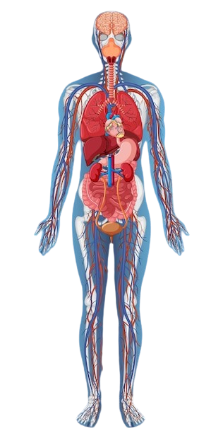
MULTIPLE
DISEASE
PREDICTION
with Rapidminer

Slide 2
Unlocking Health Insights: Predicting Multiple Diseases from Blood Samples
the reason why we choose the blood sample dataset
Rich Information: Blood samples contain a plethora of information, including biomarkers, genetic factors, and various blood cell counts. This richness can provide valuable insights into a person's health status and susceptibility to multiple diseases.
Non-invasive: Collecting blood samples is relatively non-invasive compared to other diagnostic procedures like tissue biopsies. This makes it more feasible for large-scale studies and routine health screenings.
Comprehensive Health Assessment: Blood samples can reflect the overall health of an individual, offering insights into various systems of the body. By analyzing blood samples, one can potentially predict or diagnose a wide range of diseases, from cardiovascular conditions to infectious diseases and even certain types of cancers.

Slide 3
RAPID MINER GUI:
RapidMiner is an intuitive open-source data science platform known for its user-friendly interface and robust analytics tools, facilitating efficient data preparation and predictive modeling for diverse applications.
WAYS BY WHICH WE CAN PREDICT OUR MODEL:
AUTO MODEL(RapidMiner's Auto Model feature streamlines the model building process by automatically selecting the best-performing algorithms and tuning parameters, saving time and effort in model selection and optimization)
PROCESS DESIGN(RapidMiner follows a streamlined design process model characterized by iterative stages of data preparation, modeling, evaluation, and deployment based on the alterations of user needs)

Slide 4
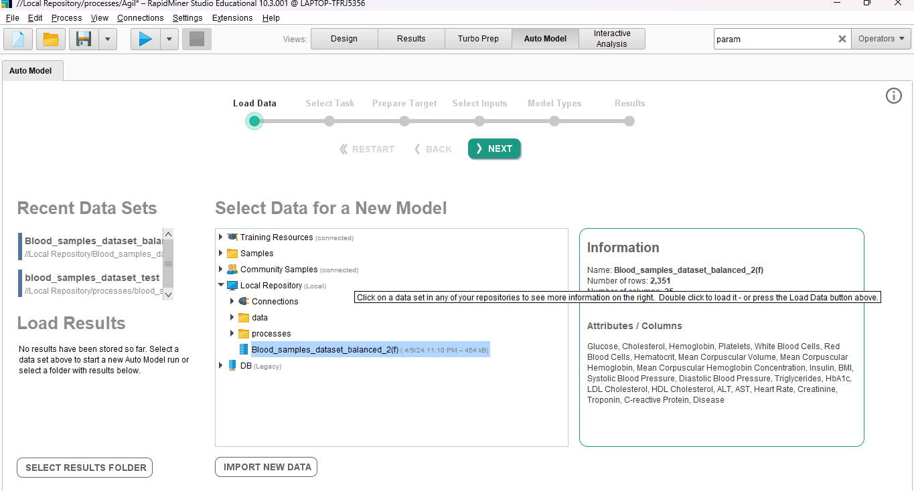
AUTO-MODEL;
Here we have to select the the data model to predict and load it into it

Slide 5
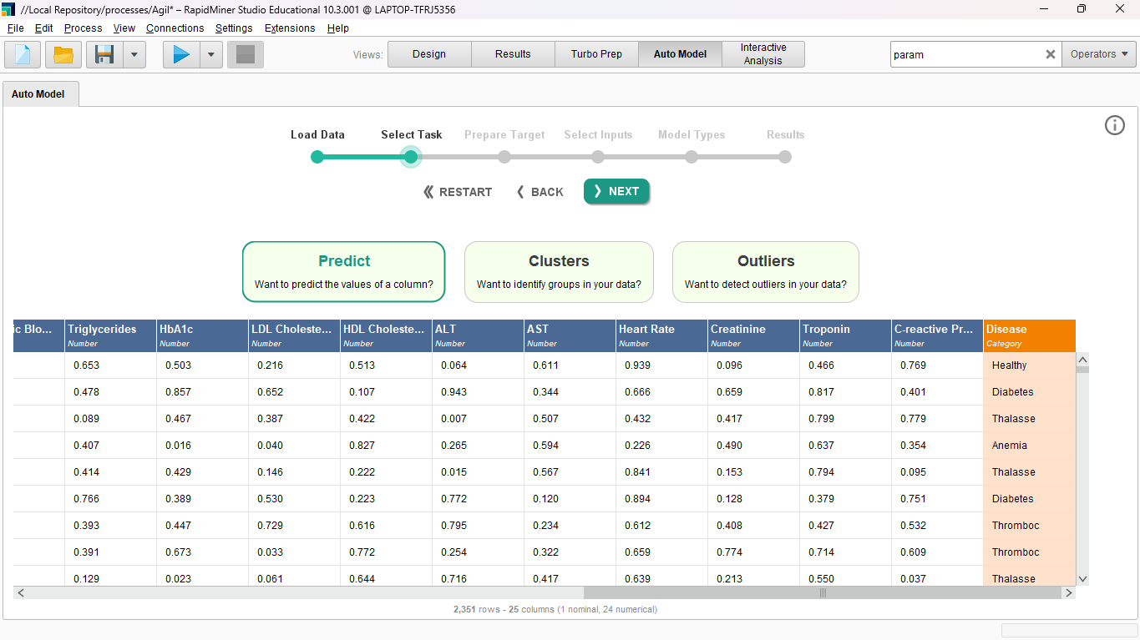
SELECTING THE TASK
In this section, we are going to choose the task we are going to perform and the label it's going to predict.

Slide 6
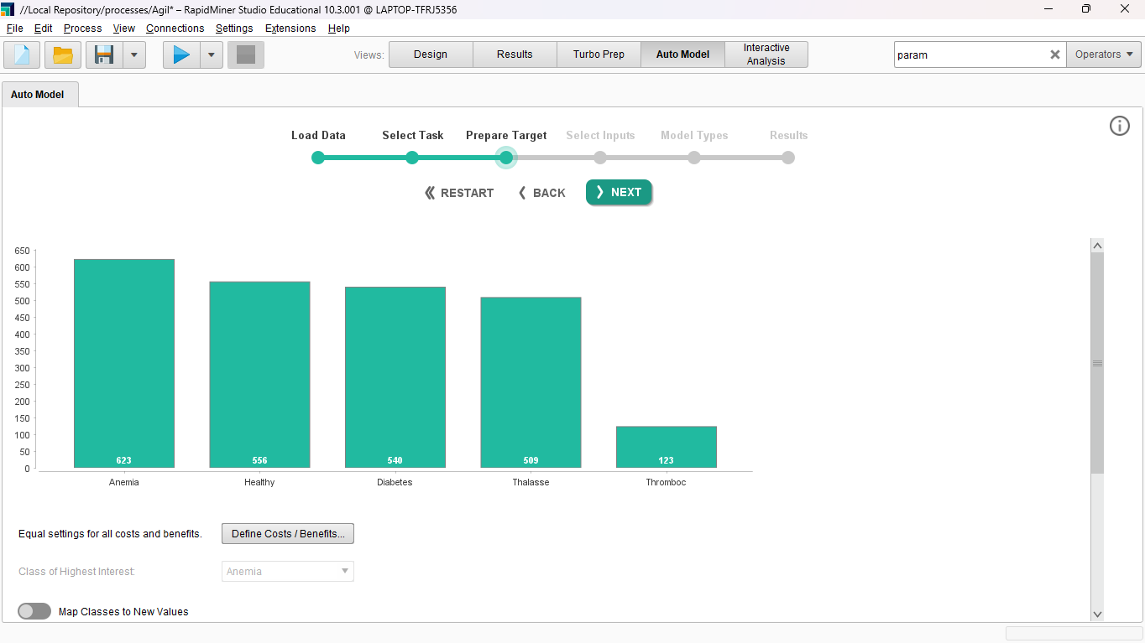
TARGET-IDENTIFICATION
In this step, we will choose the labels for which the model will assign weightage to achieve accurate predictions.

Slide 7
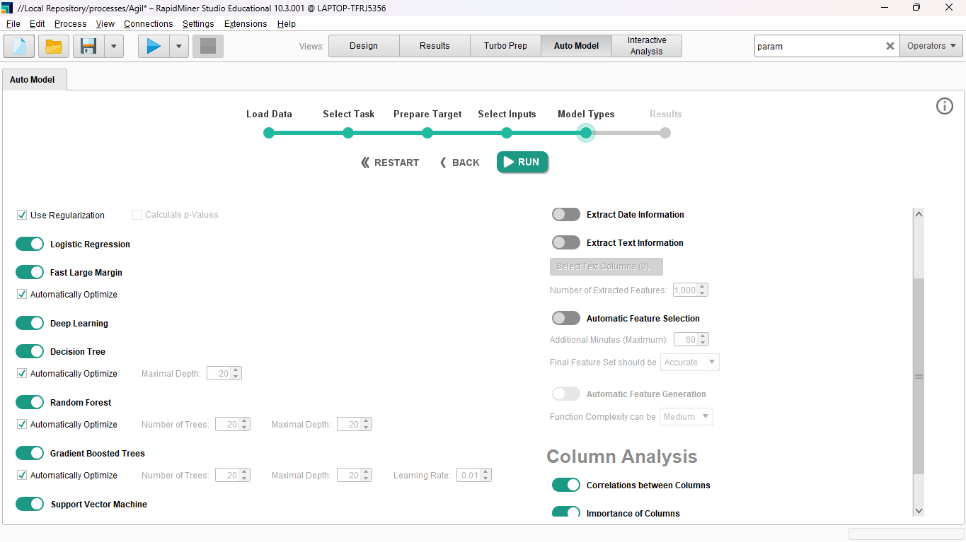
SELECT INPUTS:
​
in here we have to select the inputs for the data model which will helin the auto model for prediction of different classifications
SELECTING THE MODEL
Select the desired Machine learning models that are going to be use in the
classification and chose the column analysis the remaining classification works will be done by the auto model itself
After setting up everything now click on run

Slide 8
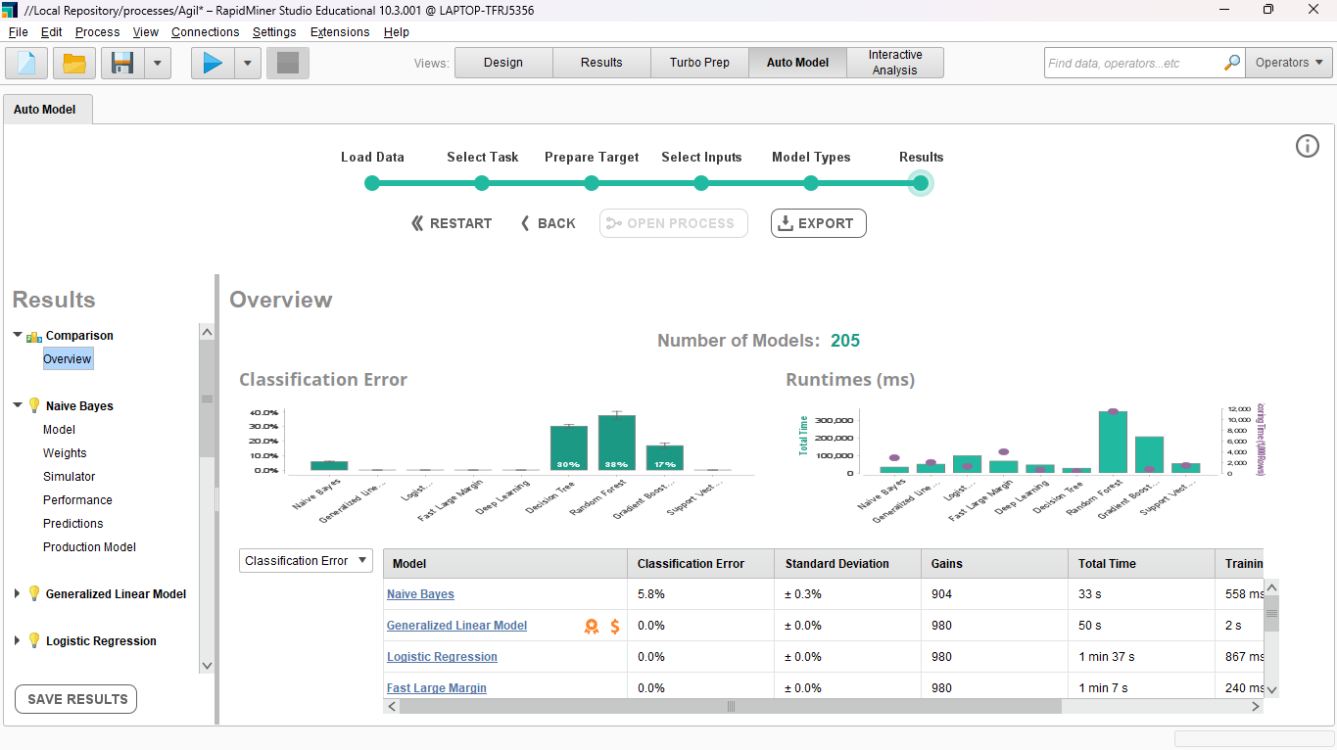
FINAL PREDICTIVE MODEL

Slide 9
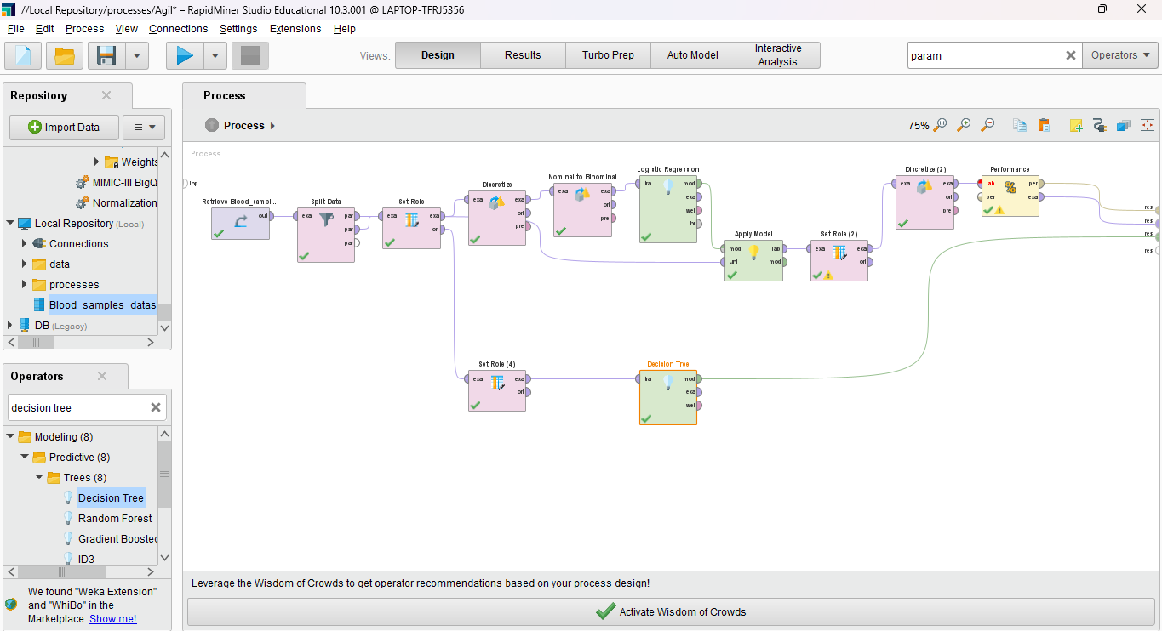
The procees design flow model

Slide 10
the process flow explaination:
First, we imported the dataset into the design panel and assigned roles to each attribute using the "setrole()" property.
Next, we divided the data into labeled and unlabeled sets using the "sortdata()" property.
Now, we're utilizing logistic regression and decision tree predictive models. We converted the models from nominal to binomial to facilitate classification operations.
After applying the models using the "Applymodel" function, we ran the process. This will display the decision tree, confusion matrix, and accuracy of the models.

Slide 11
THANK YOU!!
for taking the time to review my project. Your feedback and insights are really valuable for me.

Slide 12



